Slide 1
Programming of smart device components
Asistentas : Simonas Česnauskas

Slide 2
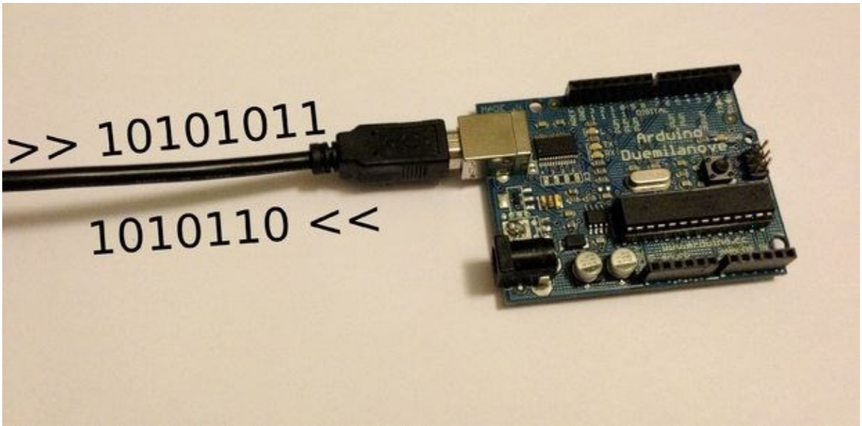
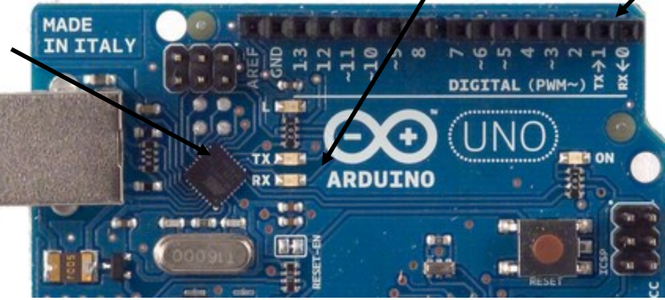
ARDUINO interfaces and analog inputs
TX and RX activity indicators
TX and RX lines
USB interface controller

Slide 3
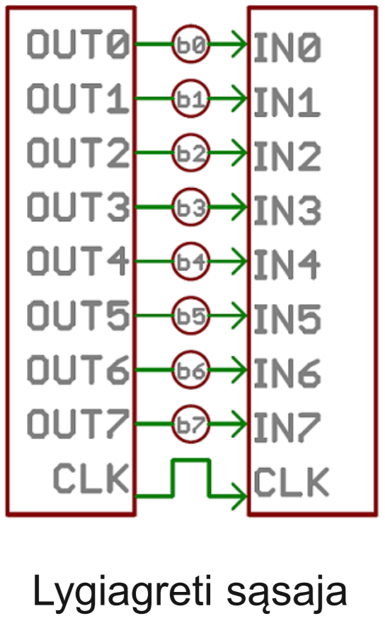
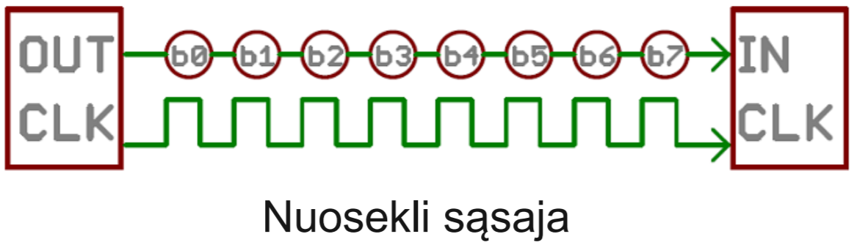
Serial data exchange
There are two options for data transmission: parallel and serial.
Because parallel transmission requires a large number of conductors (their number is equal to the number of bits transmitted), modern microprocessor technology uses a sequence where data is transmitted by a single signal wire and distributed over time.

Slide 4
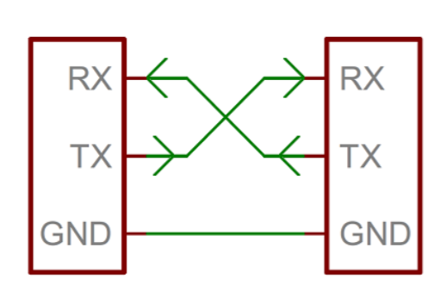
Consistent data exchange

Slide 5
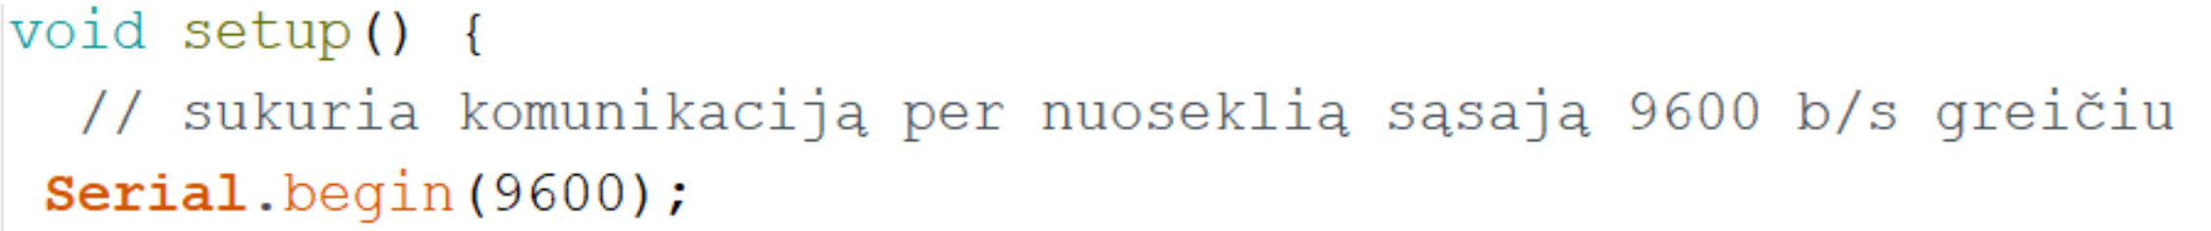
Consistent data exchange
Serial.begin (rate)
Opens a serial port and defines a serial baud rate in b / s. A typical computer communication exchange rate is 9600, although other speeds are supported.
Data transmission takes place via sequential data exchange lines RX (Receive Data) and TX (Transmit Data)

Slide 6
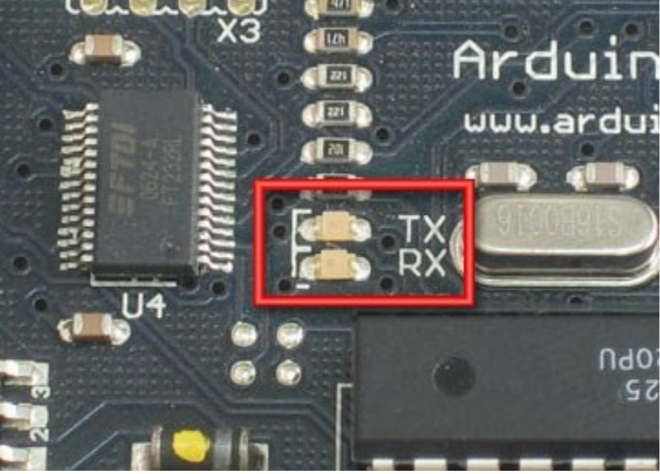
Consistent data exchange

Slide 7
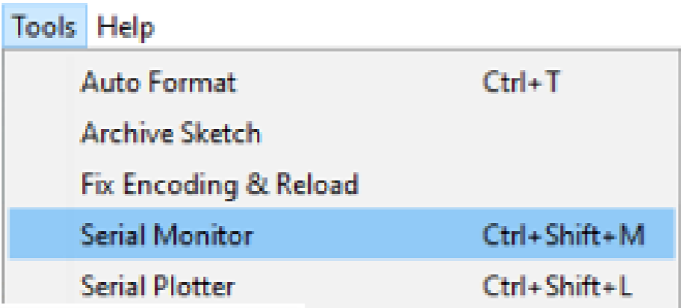
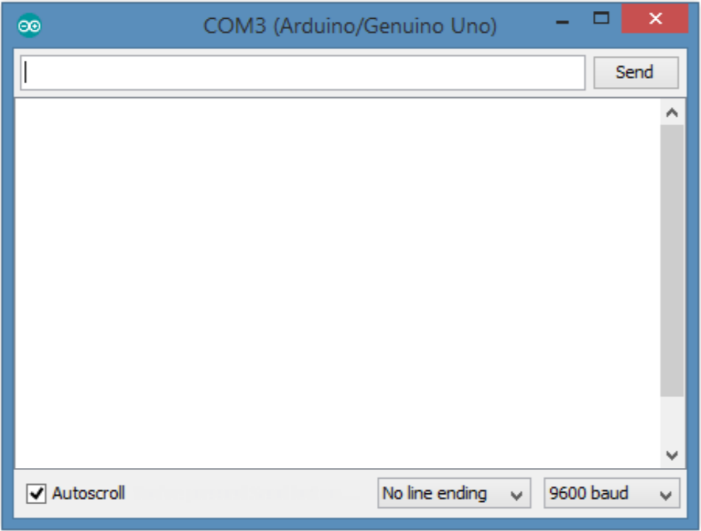
Serial Monitor user interface
Serial Monitor is a user interface that allows you to communicate with the ARDUINO controller through a graphical window. In the graphical interface it is possible not only to see how the ARDUINO controller executes the program, but also to pass commands to it.
Calling up the Serial Monitor interface :
Graphic window :

Slide 8
Serial.begin ()
Standard expression for establishing a serial interface :
Serial.begin (baud rate)
Serial – serial interface object;
. - assignment symbol;
begin – transmission setting
(baud rate) - baud rate - numeric value (9600).

Slide 9
Serial.print () / Serial.println ()
Standard serial interface definition expression:
Serial.print (data)
Serial.println (data)
print – instructions for displaying data on the screen
(data) – information that is output

Slide 10
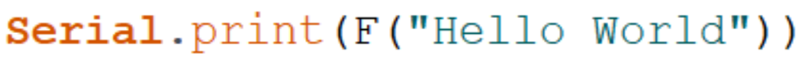
Serial.print(F(„String"))
Prints the text in quotation marks. The function is only used for text output not for processing.

Slide 11
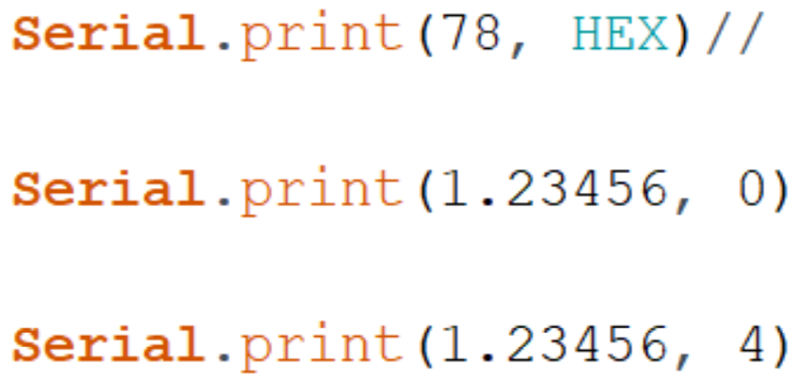
Serial.println()
Output function print () individual case output information on a new line Formatted output examples :

Slide 12
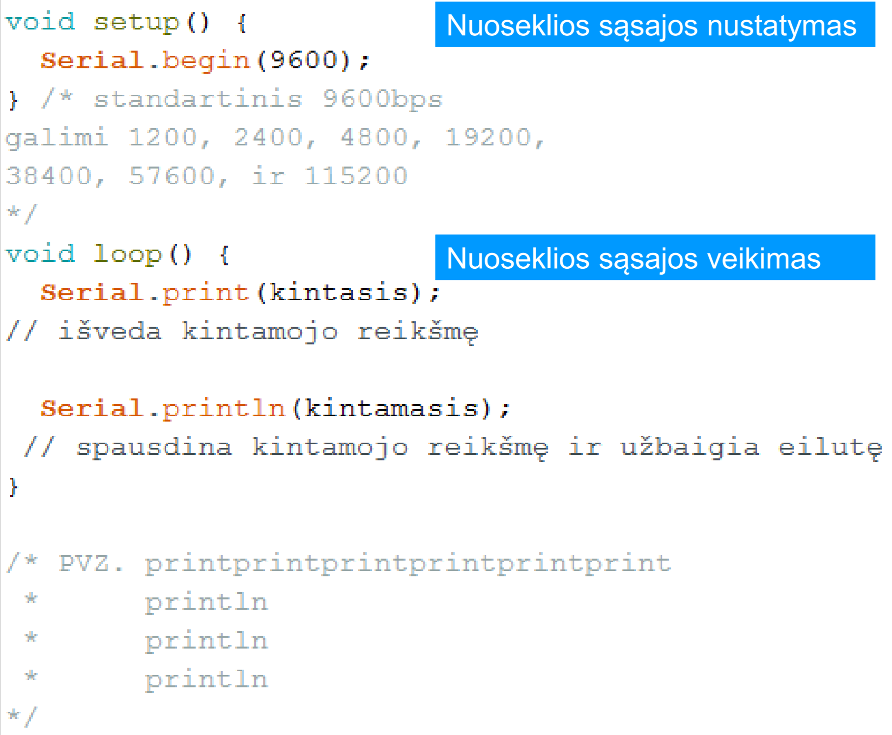
Serial Monitor Setup and Operation

Slide 13
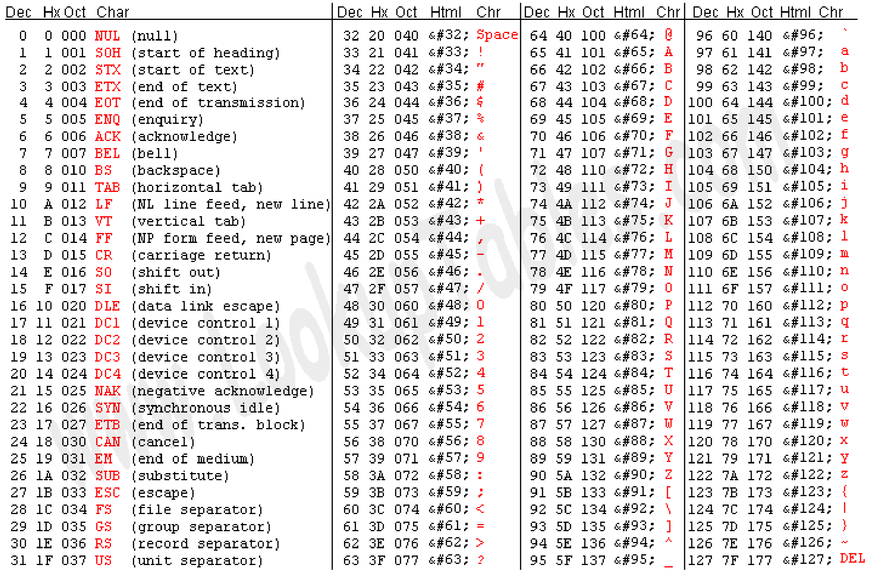
Coding of output information

Slide 14
Standardized encodings
ASCII – American Standart Code for Information Interchange 7bit.
ISO 8859-13 The text is encoded for each - 8 bits. international code standard.
For individual OS Windows-1257, DOS-775, encoding is able to encode characters in Lithuanian, Swedish and other languages.
Unicode - 16bit. An encoding that includes characters from all languages.

Slide 15
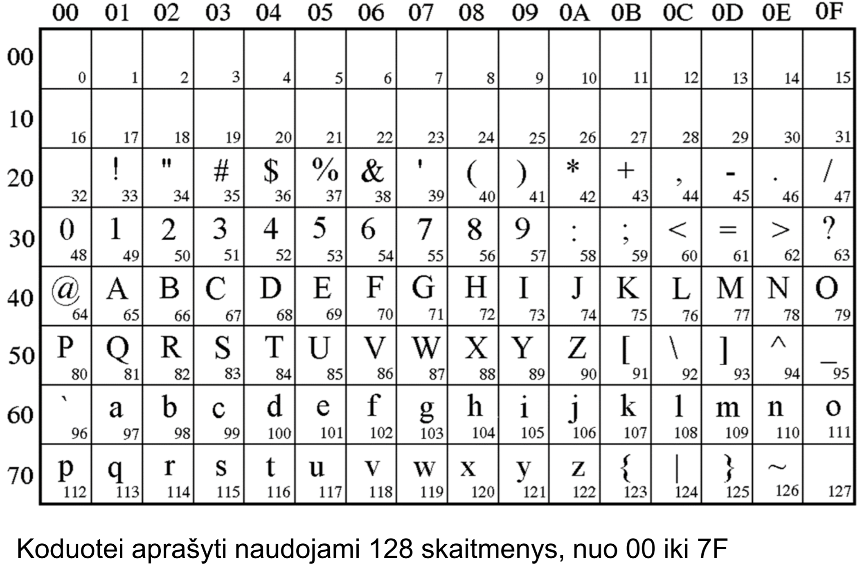
7-byte ASCII code table

Slide 16
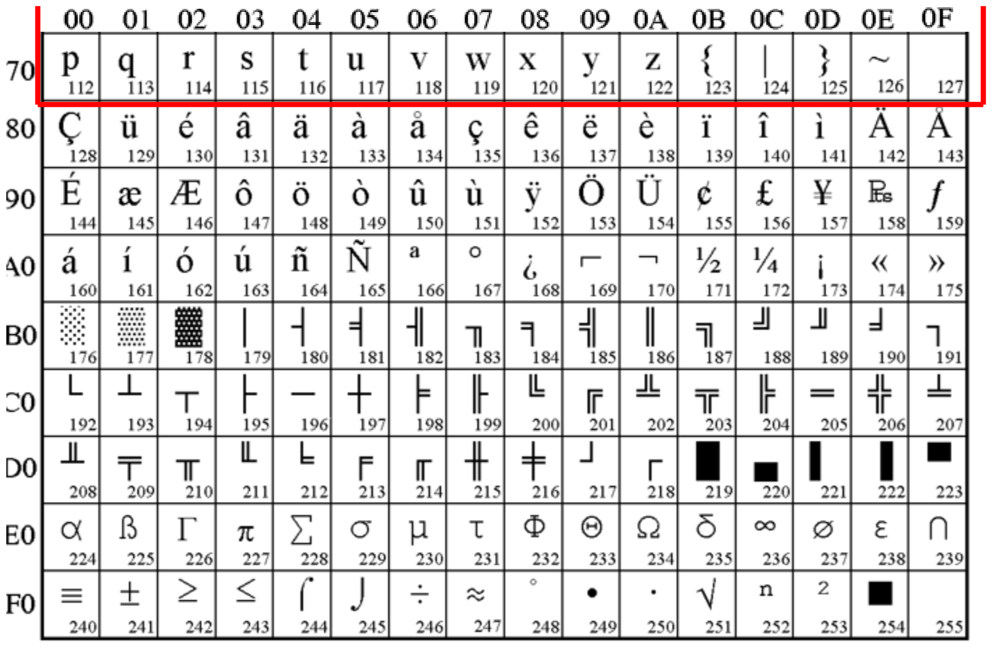
ISO 8859-13 code table

Slide 17
ASCII encoding table
ASCII American Standard Code for Information Interchange The table is for encoding characters in numbers for transmission over computer communication channels. Each character corresponds to a certain number.

Slide 18
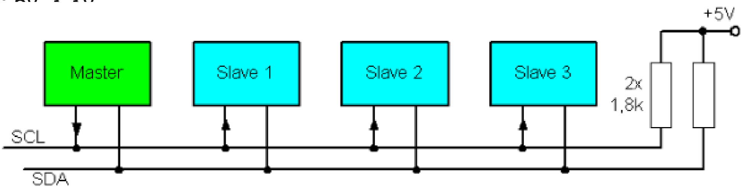
Other consistent interfaces
I2C (Inter-integrated Circuit). The protocol allows the connection of lower speed microprocessors and microcontrollers over short distances. Protocol communication between devices requires two directional lines. The most commonly used voltages are: 5v, 3.3V.

Slide 19
Other consistent interfaces
Master and several slaves. All devices are connected in series to data line (SDA) and time line (SCL).
SCL - Serial Clock Line
SDA - Serial Data Line

Slide 20
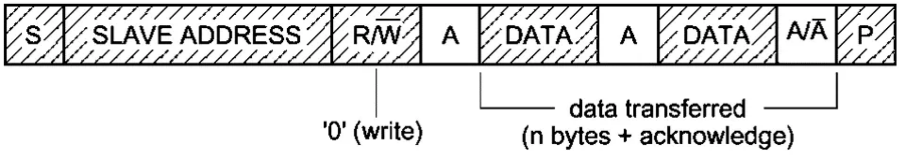
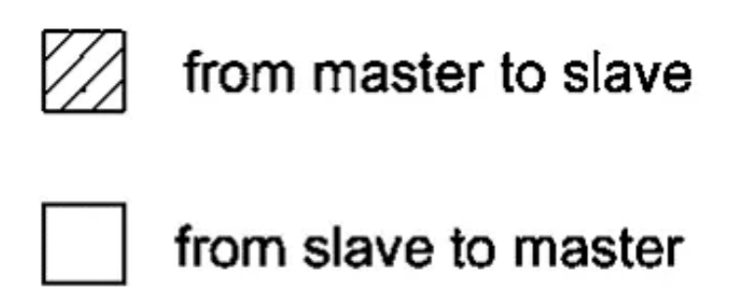
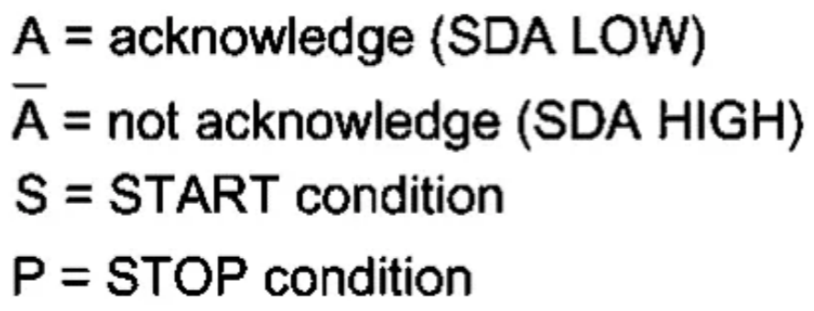
I2C data format
Startas;
Device, address selection;
Determines whether to write to or read from the device;
Device response;
Data with intermediate response;
Final answer (that you received everything);
Package end (STOP).

Slide 21
I2C programming
Programming is similar to serial interfaces, only other libraries and objects are used.
I2C is programmed as shown below.

Slide 22
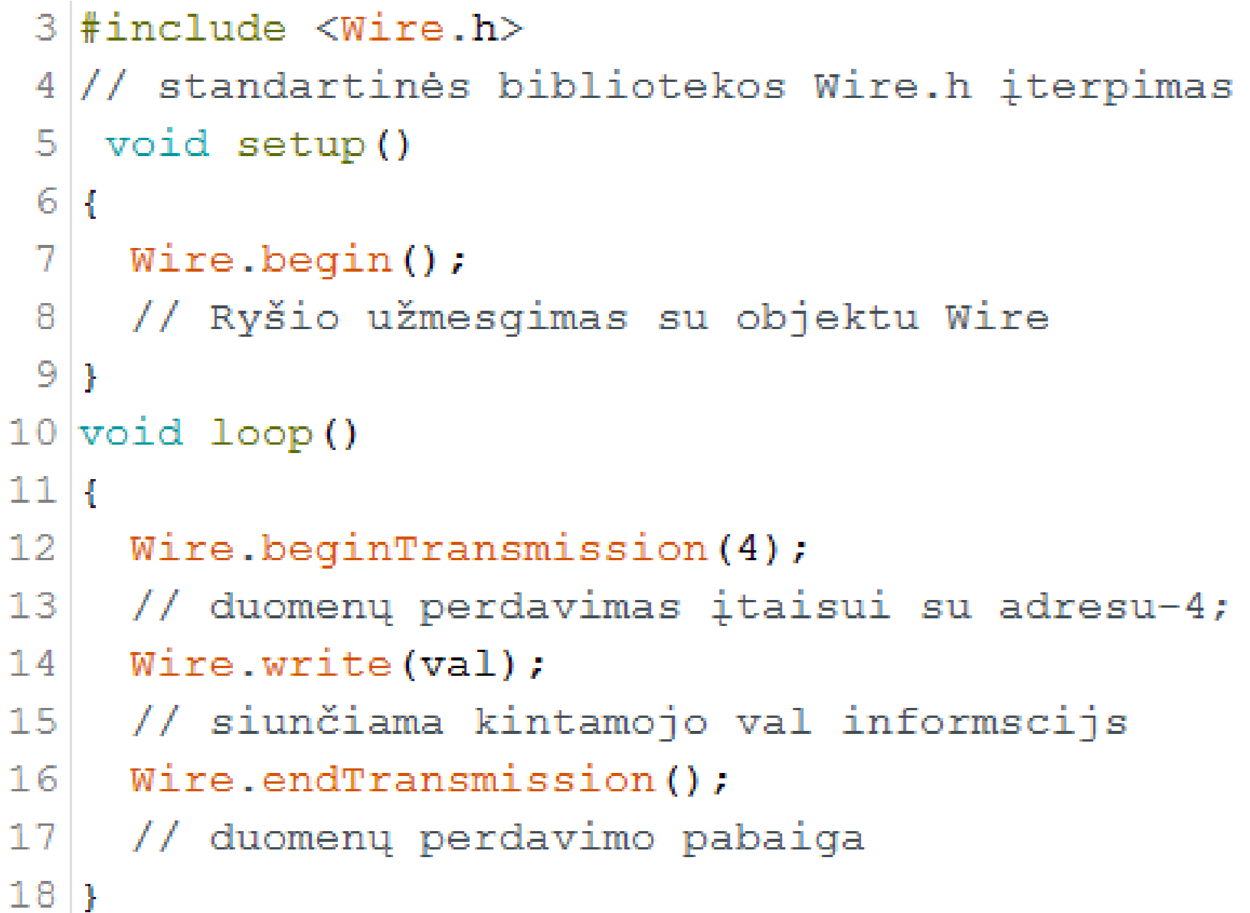
I2C programming

Slide 23
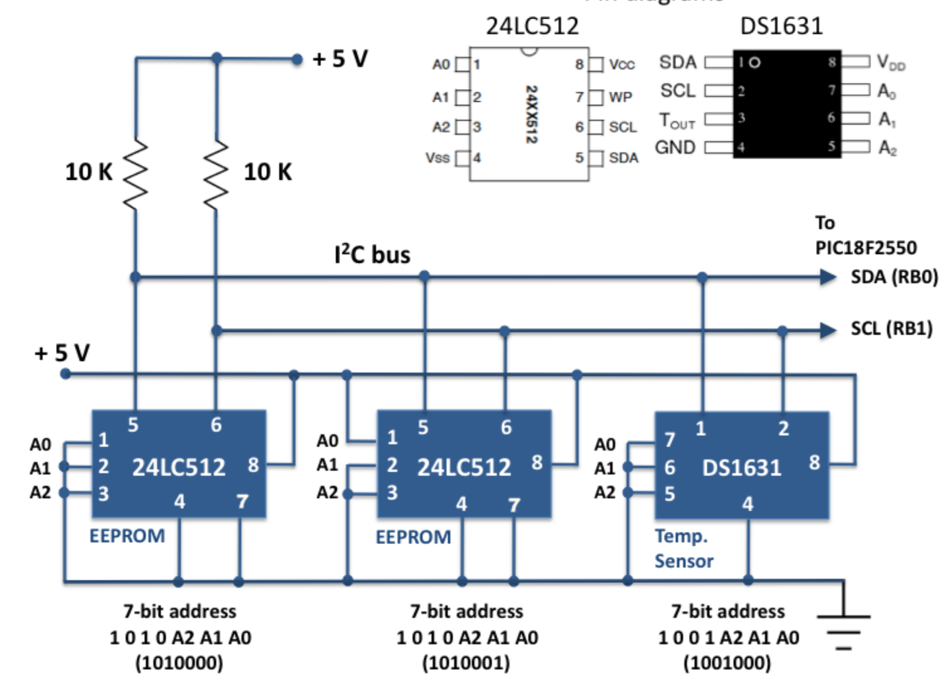
Example of I2C application

Slide 24
Microcontroller interface SPI
SPI – Serial Peripherial Interface
Data exchange takes place according to the master-slave communication logic.
There can be one master and several master devices Data can be transferred from master to master and vice versa at the same time.

Slide 25
Microcontroller interface SPI
4 signals are used :
SCK - Serial Clock
MISO – Master-in, Slave-out;
MOSI – Master-out, Slave-in;
SS - Sleve Select.

Slide 26
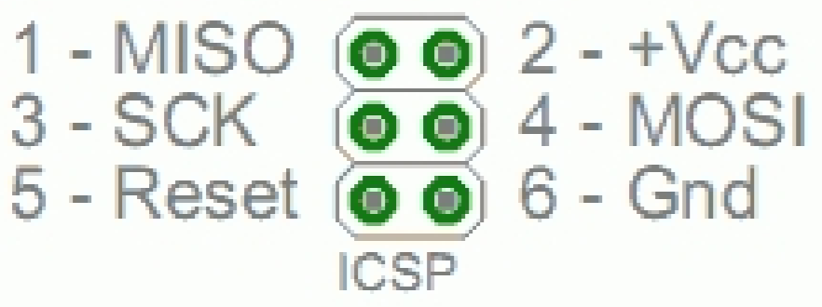
Microcontroller interface SPI
The device uses an (In-Circuit Serial Programming) interface to program the microcontrollers :

Slide 27
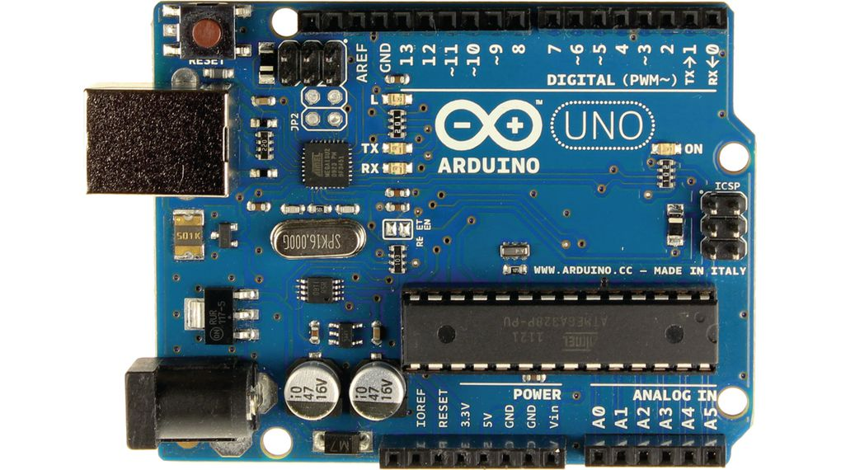
Microcontroller interface SPI

Slide 28
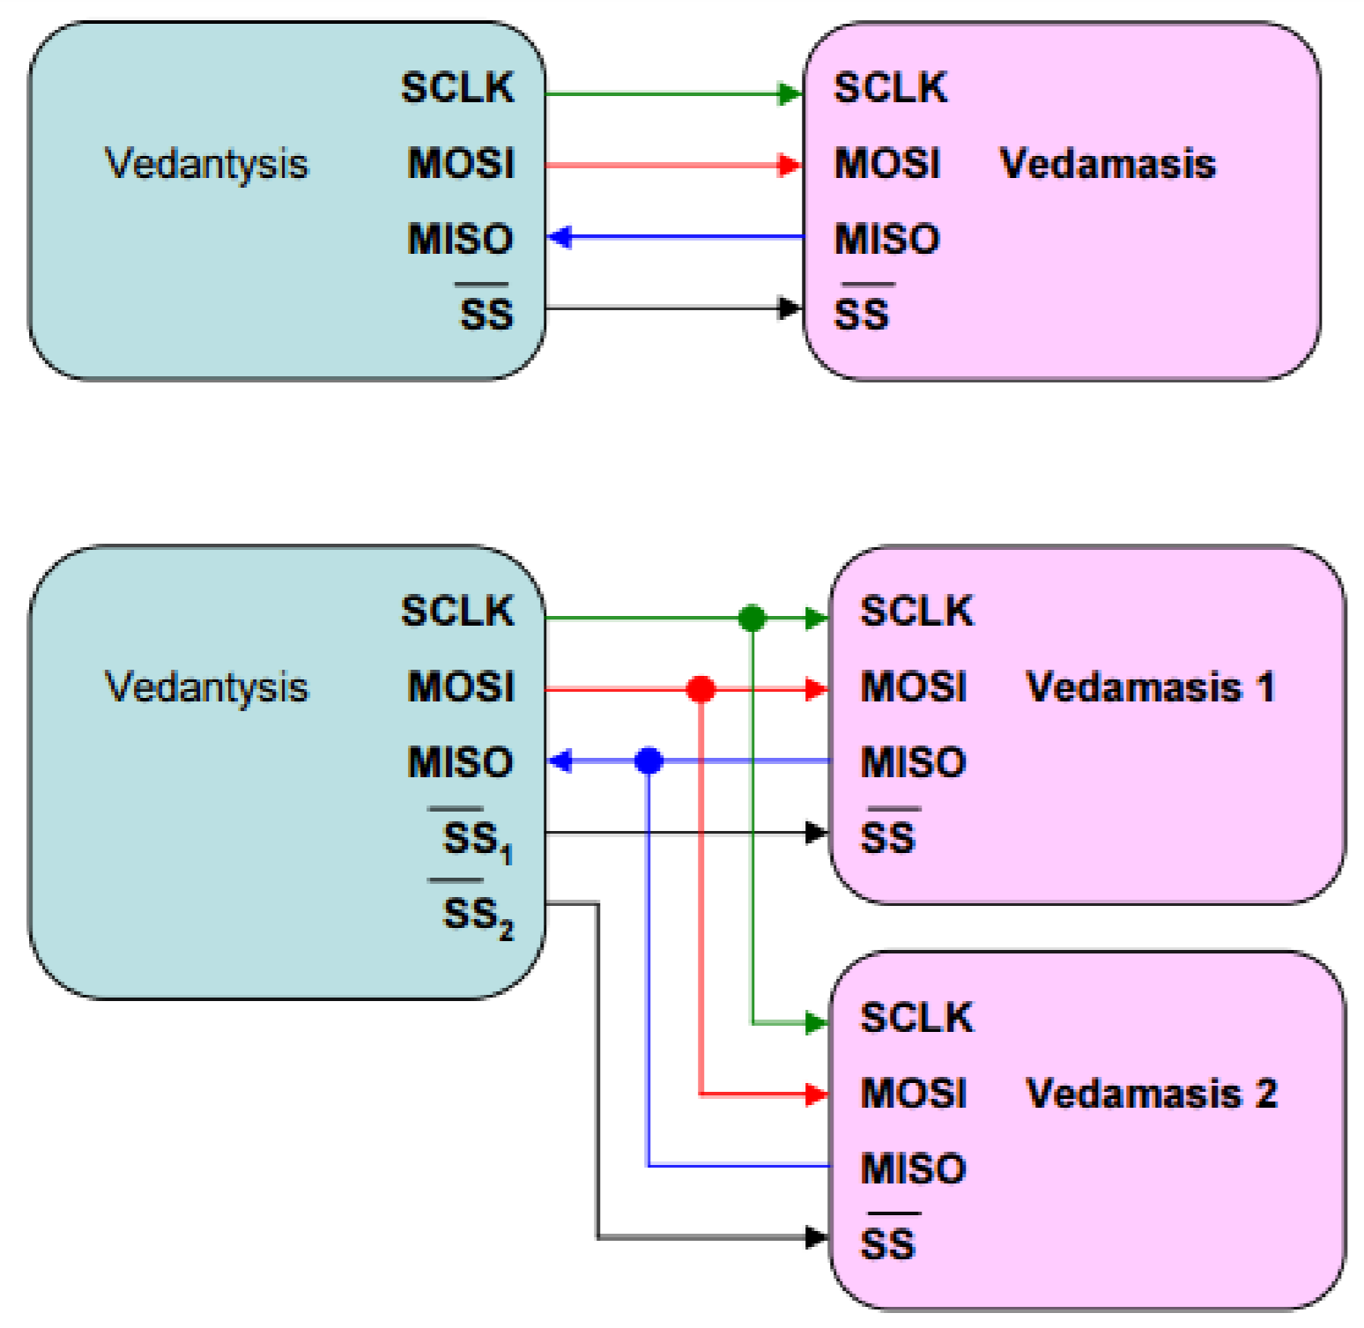
Scripts for connecting devices via SPI
Master
slave
Master
slave1
slave2

Slide 29
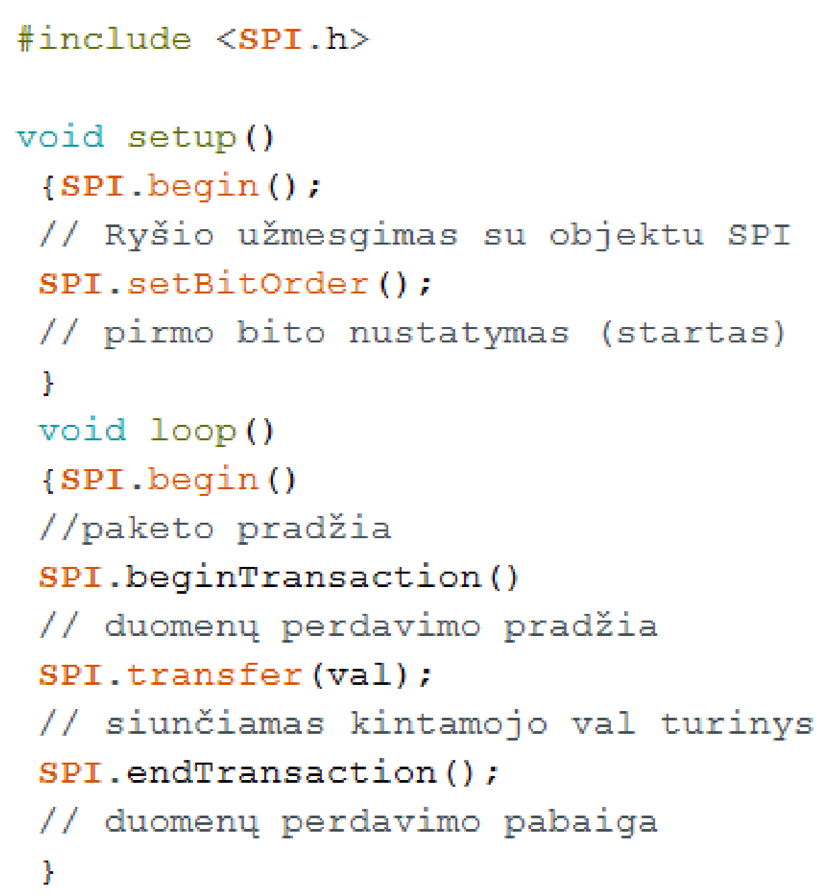
SPI programming
Data transmission SPI interface abstract code :

Slide 30
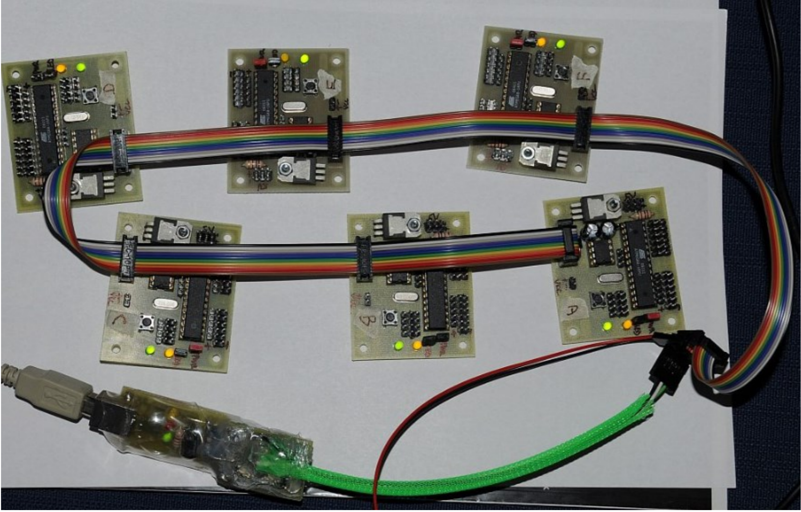
Example of SPI application

Slide 31
Goodbye

